Slide 1
Nutritional and energy value of food
Sára Dávidová
Alexa Kováčová
Zuzana Kevelyová

Slide 2
Nutritional and energy value of food
OUTLINE
1, What are calories?
2, What is Nutri-Score?
3, Carbohydrates , proteins and fats
4, Vitamines
5, Water
6, Minerals
7, Fibre

Slide 3
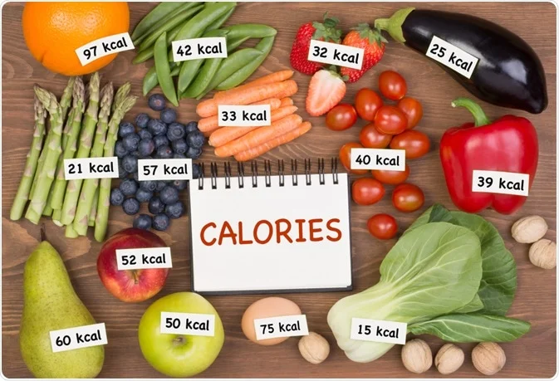
1. What are calories?
Calories are physical units that measure heat and energy
The food we eat supplies our bodies with calories, providing the energy we need to live and stay healthy
The nutritional energy contained in fat, proteins, carbohydrates is expressed in kilocalories and makes up your daily caloric intake

Slide 4
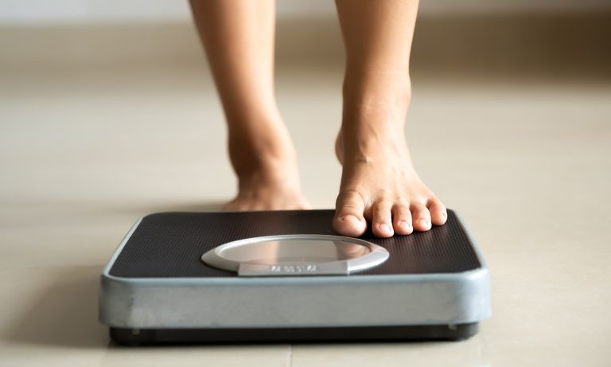
Why should we count calories?
Calories in food provide essential energy that we need for healthy life and condition
Excess calories are stored as body fat
Your body needs some stored fat to stay healthy, but if you eat too many calories you will gain weight
Too much fat brings weight gain that can cause health problems- that´s why we should count the calories
However, there is a way how to get rid of excess calories - to exercise

Slide 5
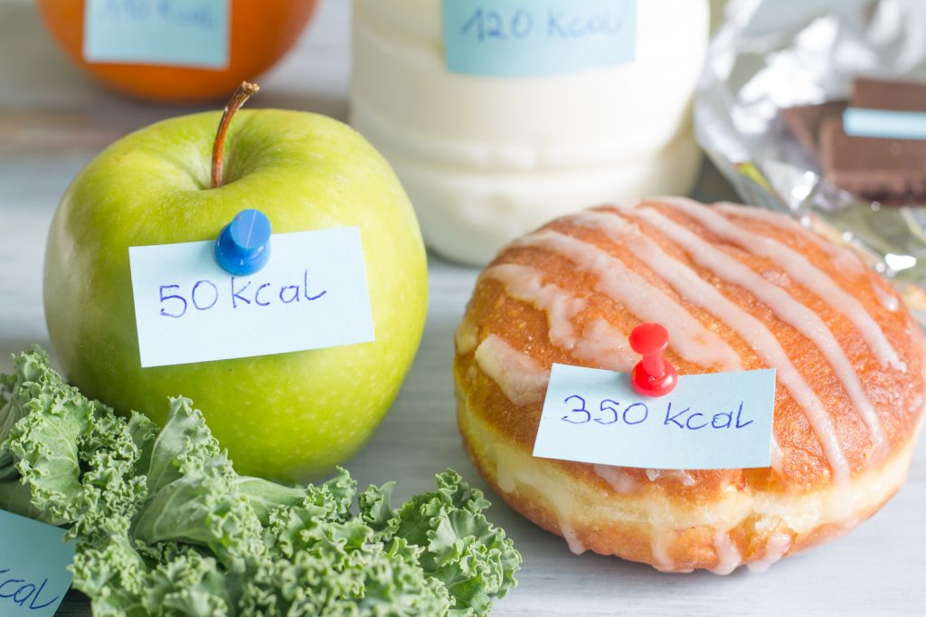
Good or bad calories?
We should also distinguish which calories are good for our body and which ones are bad
We shouldn´t consume too much sugar, and we should distinguish which sugar is healthy for our body
The „good“ calories are important for our body, they are in healthy food like fruit , vegetables, nuts but also in lean meat

Slide 6
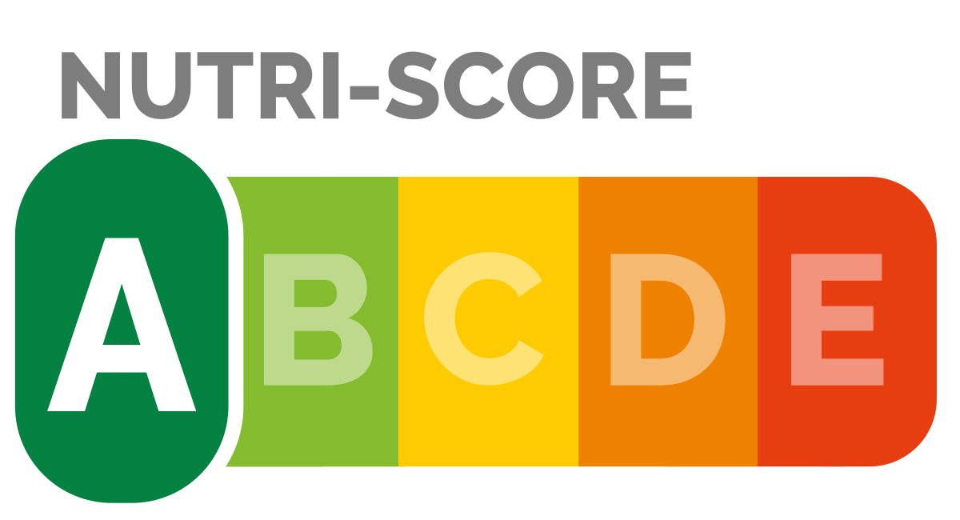
2. What is Nutri-Score?
Nutrition labeling of foods is an important advice for consumers when they decide about healthy eating
Its purpose is to help the consumers to see, interprete and understand the nutritional quality of the product better and to choose the right food
It is based on scale of 5 colours and letters (A is green to represent the best nutritional quality while E is dark orange to show it´s the lowest quality)

Slide 7
Where is it used?
The French government has been recommending food companies and retailers to use Nutri-Score since 2017
Belgium and Spain introduced this idea the following year.
In September 2019, Germany also announced that it would introduce the Nutri-Score

Slide 8
Why Nutri-Score?
1, It is the easiest label to understand
- The experience in several countries shows that Nutri-Score is currently the best- perfoming scheme that helps consumers compare the nutritional value of food within a wide range of products.
2, It makes consumers shopping baskets healthier
- Research has shown that it is the label that works best in making consumers’ food choices healthier
3, It helps consumers eat smaller portions

Slide 9
What is the situation like in EU?
Since 2017 all food and non-alcoholic drinks on sale in EU must carry a nutritional declaration on the back of the pack. But few consumers can take the time to read the nutritional table and need something that sums it up quickly.
A simplified nutritional label on the front of the pack with colour-coding allows them to spot instantly the healthier yoghurt or snack
Why do we need simple nutritional labels?
One third of children and half of adults in the EU are overweight or obese. Excess weight increases a person’s risk to develop nutrition-related chronic diseases such as diabetes and cancer.

Slide 10
Different foods-different nutri-score
1. cereals A, fresh bread B, long-lasting bread C
2. raw vegetables and fruit A, vegetable and fruit products B, vegetable oil C
3. milk A, milk products B, cheese D
4. fish, poultry, eggs A, red meat, fish products B, fatty meats D
5. pulses ( beans, peas, lentils) A, nuts and seeds B
6. sweets D, animal fat E

Slide 11
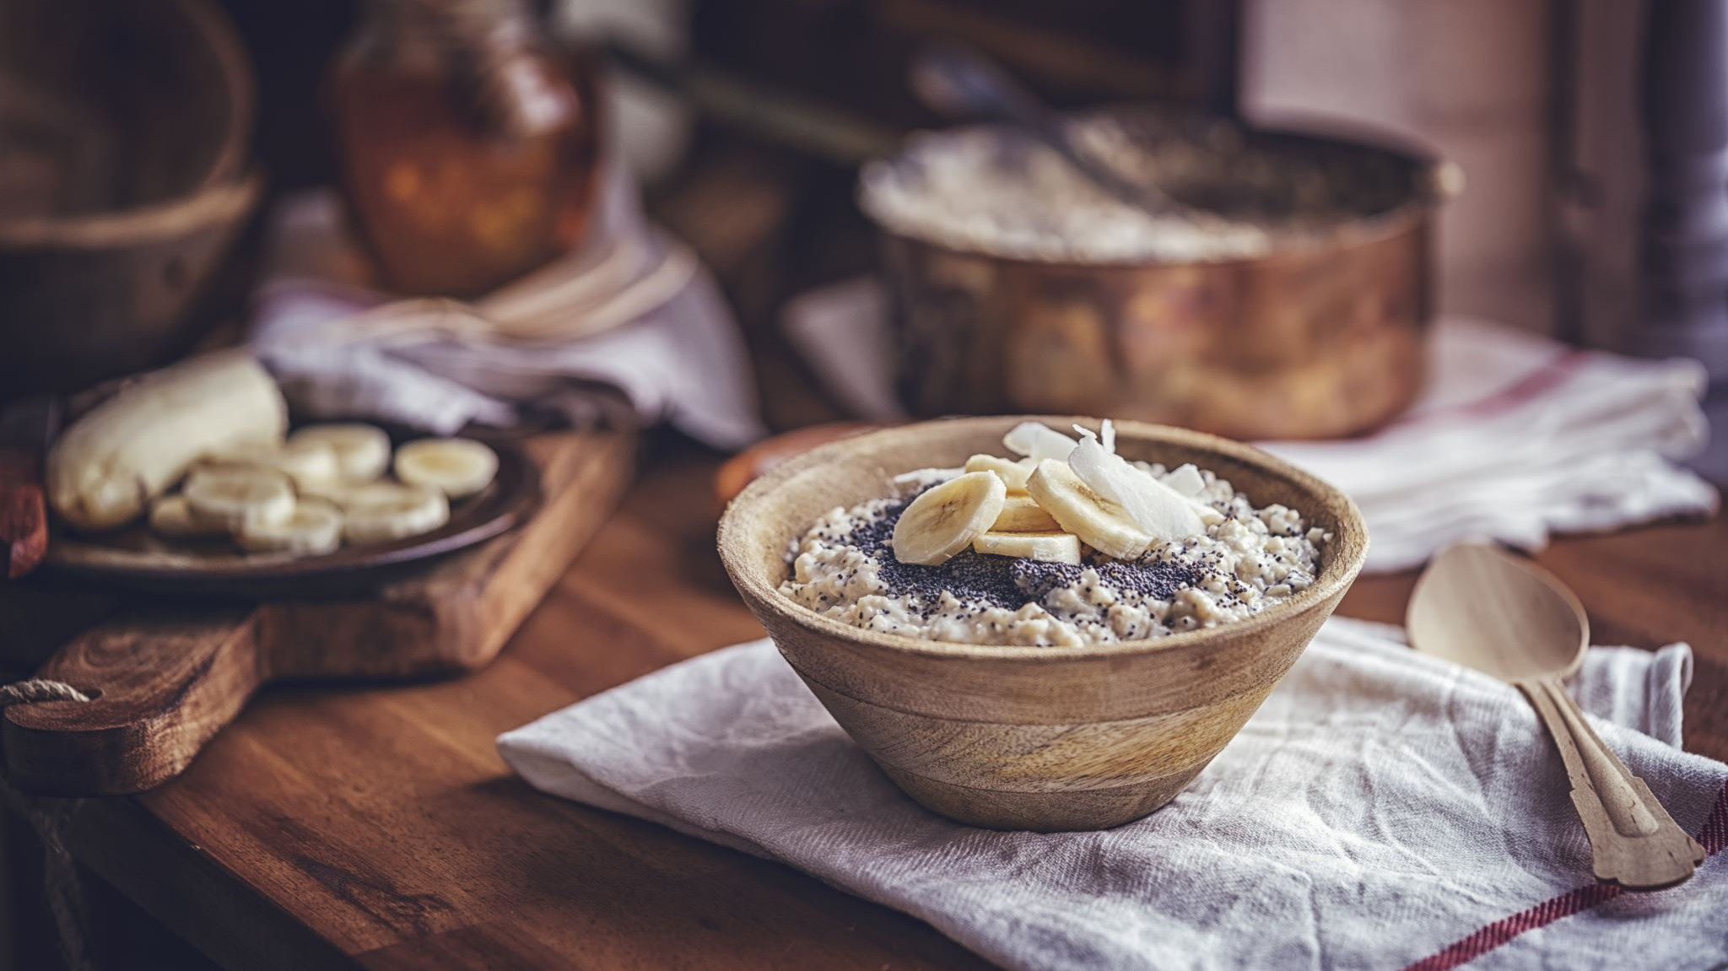
3. Carbohydrates, proteins and fat

Slide 12
Carbohydrates
are the sugars, starches and fibers found in fruits, grains, vegetables and milk products
they′re also macronutrients which means they are one of the three main ways the body obtains energy, or calories
they′re the body's main source of energy
at the chemical level, they contain carbon, hydrogen and oxygen that′s why they are called carbohydrates
they provide fuel for the central nervous system and energy for working muscles
they also prevent protein from being used as an energy source and enable fat metabolism and are important for brain function

Slide 13
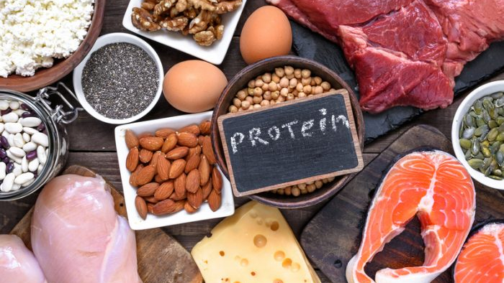
Proteins
is a macronutrient that is essential for building muscle mass
It′s commonly found in animal products, though is also present in other sources, such as nuts and pulses
protein is composed of amino acids, which are organic compounds made of carbon, hydrogen, nitrogen, oxygen or sulfur
when protein is broken down in the body it helps to fuel muscle mass, which helps metabolism
all food made from meat, poultry, seafood, beans and peas, eggs, processed soya products, nuts and seeds are sources of protein

Slide 14
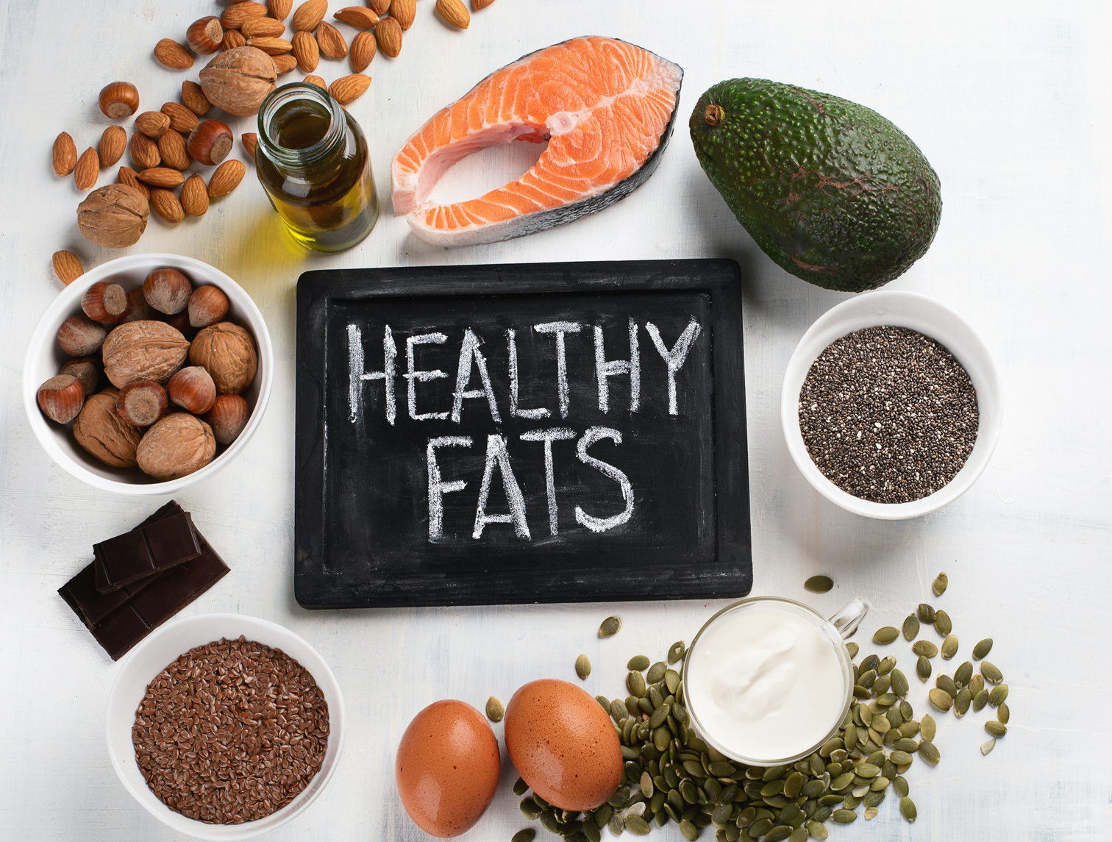
Fats
fats are one of the three main macronutrients
They are the main components of common food like milk, butter, lard, bacon and cooking oils
they are a major source of food energy
the human body can produce the fat that it needs from other food ingredients, except for a few essential fatty acids that must be included in the diet
all fats contain 9 calories per gram of fat. This is more than twice the amount found in carbohydrates and protein
you should get no more than 25% to 30% of your daily calories from fats.

Slide 15
Saturated or unsaturated fats?
Saturated fats are most often solid at room temperature. Foods like butter, palm and coconut oils, milk, cheese, and red meat have high amounts of saturated fat.
Too much saturated fat in your diet can lead to heart disease and other health problems.
Unsaturated fats are mostly liquid and found in foods from plants, such as vegetable oils, nuts, seeds as well as in oily fish- salmon, sardines,etc.
Some food like eggs contain both saturated and unsaturated fats. When they are prepared without frying, they are considered a healthy addition to your diet.
You should limit saturated fat to less than 10% of your daily calories.
All packaged foods have a nutrition label that includes fat content. Reading food labels can help you keep track of how much saturated fat you eat.

Slide 16
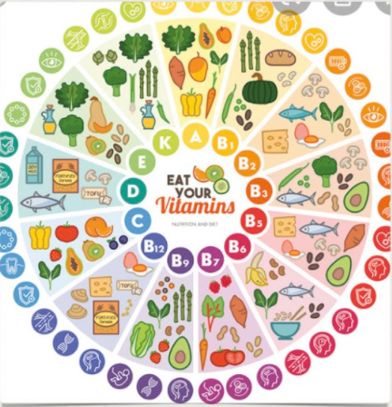
Vitamins
Vitamins have a variety of function in our body .
Bones, blood, eyes , skin, nerves and organs - all need vitamins to function and stay healthy.
Vitamins are present in food , for example. On the picture you can see which vitamin is in which food.
Vitamin D is formed by sunshine.

Slide 17
Water Advantages of drinking water
The fluid allows the blood to flow.
It trasports important nutrients to the organs, regulates body temperature via sweating .
It swarmes toxins out of the body.
More beautiful skin
More energy
Less craving
Detoxifies the body
More concetration
Stronger bones
Prevents headaches
More perfomance in sport

Slide 18
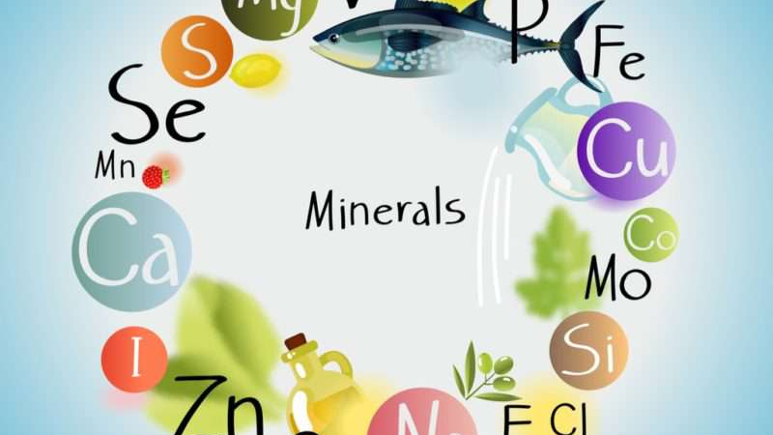
Minerals
Minerals are solid substances that are present in nature and can be made of one element or more elements combined together.
Gold, silver and carbon are elements that form minerals on their own. They are called native elements.
Atoms, ions and molecules that form a mineral are present in the space in a tidy way and according to well-defined geometrical shapes, which are called crystal lattices.
Minerals are important for your body to stay healthy. Your body uses minerals for many different jobs, including keeping your bones, muscles, heart, and brain working properly.
Minerals are also important for making enzymes and hormones.

Slide 19
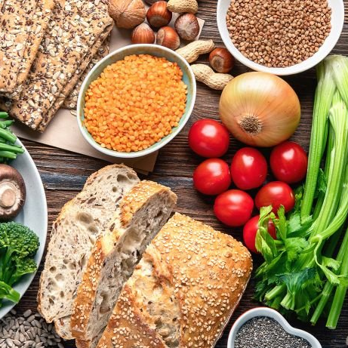
Fibre
Fiber is vital importance to degestion.
It helps the body move food through the digestive tract, reduces serum cholesterol, and contributes to disease protection.
Fibre rich foods include: wholegrain breakfast cereals, wholewheat pasta, wholegrain bread and oats , fruit, vegetables, nuts and seeds.
Also potatoes , fruits and vegetables contain a lot of fiber.
It can help digestion and prevent constipation.

Slide 20
https://slovenskypacient.sk/viete-co-je-nutri-score-ukaze-ktore-potraviny-su-pre-vas-dobre/
https://en.wikipedia.org/wiki/Nutri-Score
https://www.medicalnewstoday.com/articles/195878#_noHeaderPrefixedContent
https://en.wikipedia.org/wiki/Dietary_fiber

Slide 21
Thank you for watching!!!

